Slide 1
Alzheimer’s Prediction Using Quantum Algorithms
CSE3042 J Component Review
Submitted By : Madhur Singh 20BAI1321

Slide 2
Contents
Abstract
Problem Statement
Literature Review
Dataset Used and Statistics
Methodology
Data Pre-Processing
Data Augmentation
Feature Extraction using VGGNet
Quantum Encoding and Kernel
Classification using Quantum SVM
Results
Advantages of Quantum SVM
Future Work
References

Slide 3
Abstract
Alzheimer's disease (AD) involves pronounced memory loss and cognitive decline, accompanied by notable alterations in brain structure detectable through magnetic resonance imaging (MRI) scans. These observable preclinical structural changes offer a potential avenue for early AD detection through image classification tools, such as convolutional neural networks (CNNs). However, most studies related to AD face limitations due to small sample sizes. Identifying an effective approach to train an image classifier with restricted data remains a crucial challenge.
This study investigates the efficacy of quantum algorithms in classifying an MRI Image into AD, MCI and NC. Comparison to classical algorithms is also made, showcasing the advantages derived from quantum parallelism, superposition, and entanglement.

Slide 4
Problem Statement
The existing challenge in Alzheimer's disease (AD) research lies in the effective utilization of magnetic resonance imaging (MRI) to detect preclinical structural changes associated with severe memory loss and cognitive impairment. Although the potential for early AD detection through image classification tools like convolutional neural networks (CNNs) is recognized, the majority of related studies face limitations imposed by small sample sizes. The critical problem addressed in our ongoing project is the development of an efficient approach for training image classifiers on limited data, particularly focusing on different transfer-learning methods based on CNNs and then utilizing quantum algorithms for faster convergence to the solution.

Slide 5
Literature Review
Name of the Paper | Journal & Year | Method Used | Dataset | Advantages | Limitations | Metrics
Hierarchical Feature Representation and Multimodal Fusion with Deep Learning for AD/MCI Diagnosis | NeuroImage, 2014 | Deep Boltzmann Machine Model | Alzheimer's Disease Neuroimaging Initiative (ADNI) | Deep Boltzmann Machine model can hierarchically find feature representations in a probabilistic manner. Rather than using the noisy voxel intensities as features the high-level representation obtained via DBM is more robust to noises and thus helps enhance diagnostic performances. | The number of hidden units in each layer was manually determined in the experiments, and the relatively small dataset may not have led to the optimal network structures for discovering high-level feature representations. The current method focuses on the bi-modalities of MRI and PET, excluding the potential benefits of combining information from various modalities. | Accuracy Obtained was 95.35%

Slide 6
Literature Review
Name of the Paper | Journal & Year | Method Used | Dataset | Advantages | Limitations | Metrics
Detection of Subjects and Brain Regions Related to Alzheimer's Disease Using 3D MRI Scans Based on Eigenbrain and Machine Learning | Frontiers in Computational Neuroscience, 2015 | Eigenbrain Analysis, Machine Learning | Open Access Series of Imaging Studies (OASIS) | Eigenbrain reaches very high classification accuracy, which is better than or competitive with state-of-the-art methods It can directly find discriminant voxels/regions within the whole brain It can be combined with other features, in order to increase the classification performance. | Two-Dimensional Behaviour of Eigenbrain: Eigenbrain is essentially two-dimensional, which does not reduce the redundancy along the slice direction. Computationally Intensive: There is a need of preprocessing for spatial registration, which costs large amount of computation resources. | Accuracy obtained: Linear Kernel : 91.47% Polynomial Kernel : 92.36% RBF Kernel : 86.71%

Slide 7
Literature Review
Name of the Paper | Journal & Year | Method Used | Dataset | Advantages | Limitations | Metrics
Machine Learning Framework for Early MRI-based Alzheimer's Conversion Prediction in MCI Subjects | NeuroImage, 2015 | Semi-Supervised Learning, Novel Random Forest-Based Data Integration Scheme | Alzheimer's Disease Neuroimaging Initiative (ADNI) | Use of Semi Supervised Learning The aging effects within the MRI data were eliminated before the training of the classifier to avoid potential confounding arising from age-related atrophies. Incorporation of Cognitive Measurements with MRI Scans | The paper does not provide insights into which features or regions of interest contributed most to the predictions. The paper does not discuss the utilization of longitudinal MRI data. | Area Under Curve obtained was 76.61%

Slide 8
Literature Review
Name of the Paper | Journal & Year | Method Used | Dataset | Advantages | Limitations | Metrics
Multi-modal Classification of Alzheimer's Disease using Nonlinear Graph Fusion | Pattern Recognition, 2017 | Nonlinear Graph Fusion | Alzheimer's Disease Neuroimaging Initiative (ADNI) | Non -Linear Fusion Method for Combining Multiple Modalities Data Imputation to Expand Sample Size: The imputation approaches can fill the missing data of the excluded subjects so that it is likely to use as many samples as possible in the evaluation. | Lack of Demographic Data: The data used in the paper lacks demographic information about the subjects. Lack of focus on Longitudinal Data: This paper only focuses on cross-sectional data. Interesting insights can be found on using longitudinal data with graph fusion. | Area Under Curve obtained was 98.1%

Slide 9
Literature Review
Name of the Paper | Journal & Year | Method Used | Dataset | Advantages | Limitations | Metrics
Residual And Plain Convolutional Neural Networks For 3D Brain MRI Classification | arXiv, 2017 | Residual And Plain 3D Convolutional Neural Network | Alzheimer's Disease Neuroimaging Initiative (ADNI) | The proposed deep learning algorithms for brain MRI classification offer end-to-end models, eliminating the need for complex multistep pipelines and handcrafted feature generation. Leveraging modern advancements in deep learning, such as batch normalization and residual network architectures, mitigates issues associated with small training datasets while facilitating automatic feature generation. | Although suggesting data augmentation as a future research avenue, the study does not experiment with or provide details on specific augmentation techniques to enhance model robustness. The scalability and computational efficiency of such models for large-scale deployment are not extensively discussed. | Accuracy using ResNet was 80%

Slide 10
Literature Review
Name of the Paper | Journal & Year | Method Used | Dataset | Advantages | Limitations | Metrics
Early Detection of Alzheimer’s Disease Using Magnetic Resonance Imaging: A Novel Approach Combining Convolutional Neural Networks and Ensemble Learning | Frontiers in Neuroscience, 2020 | Convolutional Neural Networks, Ensemble Learning | Alzheimer's Disease Neuroimaging Initiative (ADNI) | Application of Data Augmentation Techniques to Enhance the Dataset Integration of Convolutional Neural Networks and Ensemble Learning for early detection of Alzheimer’s disease using MRI data Automatic Selection of ROIs Ability to Detect Other Neurological Problems | Lack of detailed information on the specific architecture and parameters of the utilized Convolutional Neural Networks | Accuracy obtained was 84%

Slide 11

Dataset Used
Alzheimer's Disease Neuroimaging Initiative (ADNI)
Key features of the ADNI dataset include:
Multi-Center Collaboration: ADNI is a multi-center study involving collaboration among researchers and institutions. It aims to collect data from multiple sites to ensure diversity and representativeness in the study population.
Longitudinal Data: The dataset includes longitudinal data, allowing researchers to track changes over time in individuals with different cognitive conditions. This longitudinal aspect is crucial for understanding the progression of Alzheimer's disease and related conditions. ADNI is an ongoing, multicenter cohort study, started from 2004. It focuses on understanding the diagnostic and predictive value of Alzheimer’s disease specific biomarkers.
Class Label of T1-MRI Images | Number of Images Used
AD | 1124
NC | 1440
CI | 2590

Slide 12
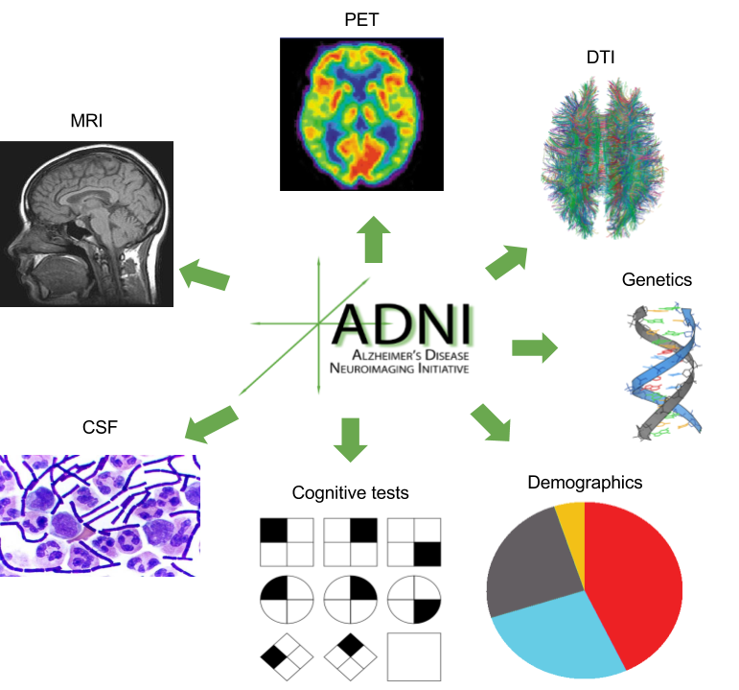
Dataset Used
Data Types:
Clinical Data: Information on participants' demographics, medical history, cognitive assessments, and clinical diagnoses.
Imaging Data: Structural and functional neuroimaging data, such as magnetic resonance imaging (MRI) and positron emission tomography (PET) scans, providing insights into brain structure and function.
Genetic Data: Genetic information is collected to investigate the role of genetics in Alzheimer's disease.
Participant Groups:
Normal Controls (NC): Individuals with normal cognitive function.
Mild Cognitive Impairment (MCI): Individuals with mild cognitive deficits that are greater than expected for their age but not severe enough to meet criteria for Alzheimer's disease.
Alzheimer's Disease (AD): Individuals diagnosed with Alzheimer's disease.

Slide 13
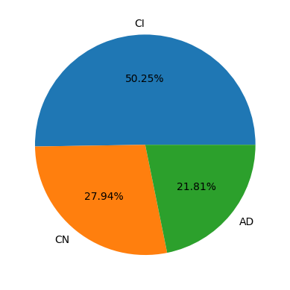
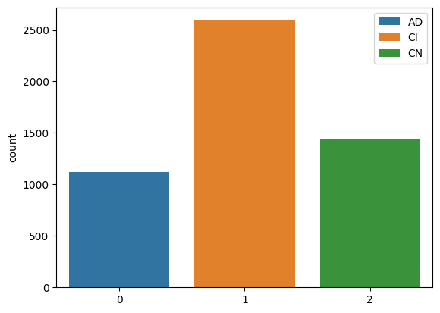
Dataset Statistics

Slide 14
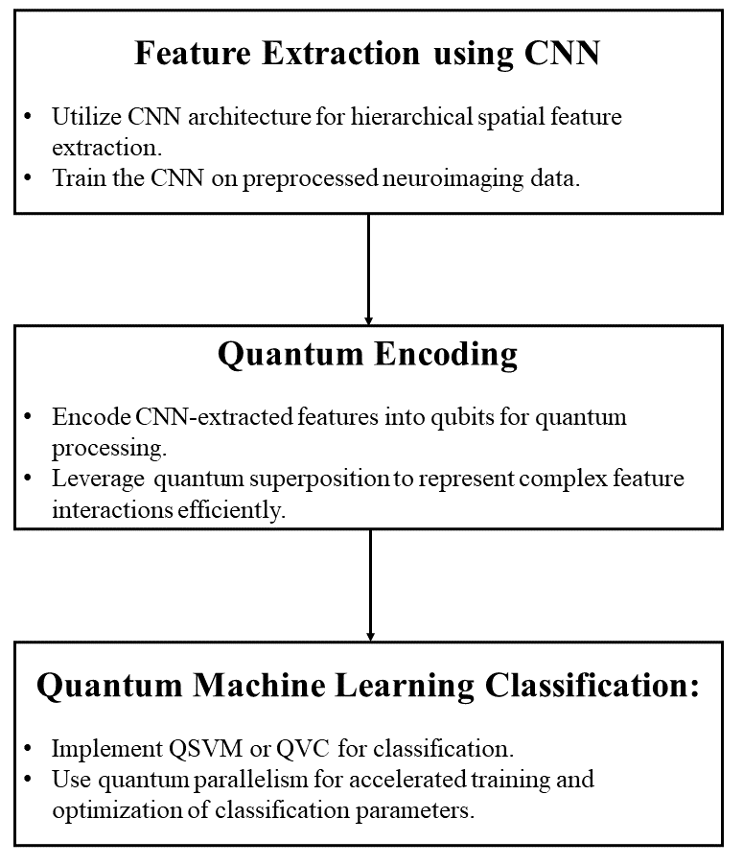
Methodology

Slide 15
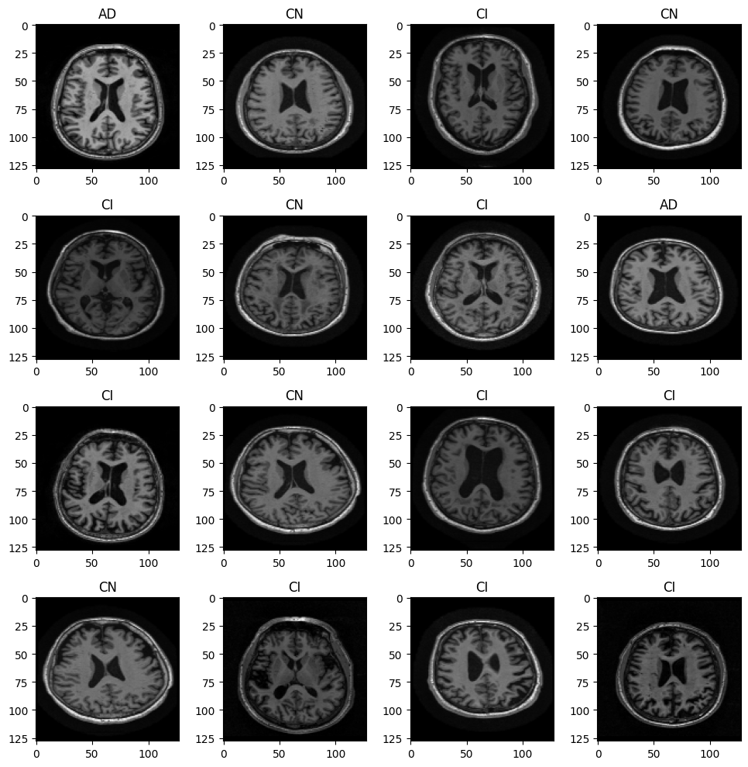
Data Pre-Processing
The MRI images obtained from the ADNI dataset were pre-processed prior to being fed to the CNN model for feature extraction.
Input shape of the images was set to be (128,128) for the VGG-16s input layer.
The MRI images are then converted to grayscale for simplification, consistency, and enhanced interpretability.
Min-Max normalization is also applied to scale pixel values between 0 and 1, ensure consistent scale and mitigate intensity variations.

Slide 16
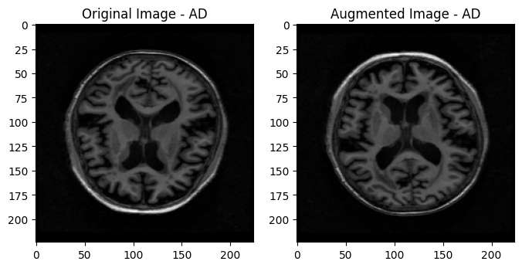
Data Augmentation
Data augmentation applied is a combination of horizontal and vertical flips.
Data augmentation is a common technique used during training to artificially increase the diversity of the training dataset. By applying random transformations to the input data, the model becomes more robust and less sensitive to variations in the input images. This can help improve the generalization performance of the model on unseen data.

Slide 17
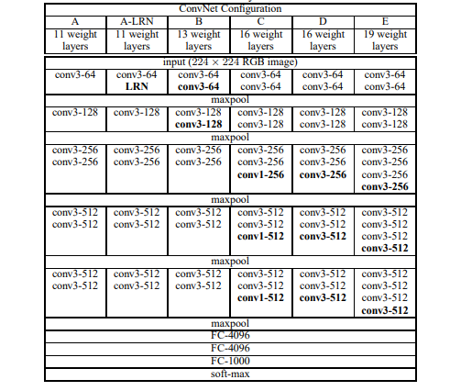
Feature Extraction using VGG-Net
VGG16 Architecture: Utilizes a 16-layer pre-trained Convolutional Neural Network (CNN) originally trained on large-scale image datasets.
Feature Extraction: Passes medical MRI images through VGG16, automatically extracting hierarchical and abstract features at multiple convolutional layers. Last layer of the model is deleted to obtain a feature map.
Robust Representation: Enhances the model's ability to discern discriminative features, providing a foundation for accurate medical image analysis tasks like disease classification and segmentation.
VGGNet excels with hierarchical features, proven versatility, simplicity, community support, and benchmark performance, making it advantageous for diverse tasks.

Slide 18
Quantum Encoding and Quantum Kernel
Quantum encoding uses qubits to represent features. These qubits can exist in a combination of 0 and 1 states simultaneously, allowing for the exploration of multiple possibilities at once. Quantum feature maps, like ZZFeatureMap in Qiskit, define a quantum circuit that transforms classical data into a quantum state, leveraging the unique properties of quantum mechanics.
A quantum kernel refers to the use of quantum circuits to compute the inner product of feature vectors in a quantum-enhanced manner. Traditional SVMs use classical kernels, such as the radial basis function (RBF) kernel, to measure the similarity between pairs of data points.
It introduces quantum computation to perform these similarity calculations. Quantum computers can potentially handle a vast number of parallel computations due to the principles of superposition. Quantum kernel methods aim to exploit this parallelism to process large amounts of data more efficiently than classical method.
Feature Map
The quantum kernel begins with a quantum feature map, which encodes classical input data into qubits using quantum gates.
Quantum Circuits
The quantum kernel then utilizes quantum circuits to compute the inner product or similarity measure between pairs of quantum states.
Measurement
The final step involves measuring the quantum state to obtain a classical result. This is the quantum enhanced similarity between the input feature vectors.

Slide 19
Classification using Quantum SVM
The quantum kernel is then used to find support vectors, which are the critical data points that influence the decision boundary in SVM. Quantum algorithms are applied to identify these support vectors in a way that could provide a speedup compared to classical methods.
Accuracy of 98.2% is achieved as compared to 93.5% when we used classical SVM with quantum kernel.

Slide 20
Results
Metric | AD | MCI | NC
True Positives | 2164 | 2165 | 2154
True Negatives | 4334 | 4323 | 4332
False Positives | 3 | 14 | 6
False Negatives | 5 | 4 | 14
Precision | 99.8% | 99.3% | 99.7%
Recall | 99.7% | 99.8% | 99.3%
F1 Score | 99.8% | 99.5% | 99.5%

Slide 21
Advantages of Quantum SVM
Quantum Feature Extraction: Utilizes quantum computing's parallelism and superposition for feature extraction, offering insights into distinguishing cognitive states.
Dimensionality Reduction: Quantum nature of QSVM enables efficient dimensionality reduction, impacting model training time and generalization compared to classical SVMs.
Quantum Parallelism: Inherent quantum parallelism processes multiple possibilities simultaneously, aiding Alzheimer's prediction by exploring numerous feature combinations concurrently for more comprehensive model training.
Quantum Entropy: Exploits quantum entropy for a broader solution space, advantageous in optimizing model parameters and improving robustness in Alzheimer's prediction models.
Inherent Quantum Advantage: Quantum algorithms, like QSVM, offer advantages in complex feature extraction and high-dimensional data analysis, providing novel solutions where classical algorithms may struggle.

Slide 22
Future Work
Extending out research to explore the development and optimization of Quantum Convolutional Neural Networks (QCNNs) specifically designed for AD prediction
Focus on hybrid models, integrating classical and quantum components to leverage the strengths of both, and explore quantum algorithms for preprocessing tasks.
Explore the fusion of quantum predictions with multiple modalities and ensemble approaches, aiming to capitalize on the strengths of each medical modality for more robust and accurate AD predictions.

Slide 23
References
Roberts, R.; Knopman, D.S. Classification and Epidemiology of MCI. Clin. Geriatr. Med. 2013, 29, 753–772.
Petersen, R.C.; Lopez, O.; Armstrong, M.J.; Getchius, T.S.; Ganguli, M.; Gloss, D.; Gronseth, G.S.; Marson, D.; Pringsheim, T.; Day, G.S.; et al. Author response: Practice guideline update summary: Mild cognitive impairment: Report of the Guideline Development, Dissemination, and Implementation Subcommittee of the American Academy of Neurology. Neurology 2018, 91, 373–374.
Ward, A.; Tardiff, S.; Dye, C.; Arrighi, H.M. Rate of Conversion from Prodromal Alzheimer’s Disease to Alzheimer’s Dementia: A Systematic Review of the Literature. Dement. Geriatr. Cogn. Disord. Extra 2013, 3, 320–332.
26. Mitchell, A.J.; Shiri-Feshki, M. Rate of progression of mild cognitive impairment to dementia—Meta-analysis of 41 robust inception cohort studies. Acta Psychiatr. Scand. 2009, 119, 252–265.
27. Sherman, D.S.; Mauser, J.; Nuno, M.; Sherzai, D. The Efficacy of Cognitive Intervention in Mild Cognitive Impairment (MCI): A Meta-Analysis of Outcomes on Neuropsychological Measures. Neuropsychol. Rev. 2017, 27, 440–484.
Olsson, B.; Lautner, R.; Andreasson, U.; Öhrfelt, A.; Portelius, E.; Bjerke, M.; Hölttä, M.; Rosén, C.; Olsson, C.; Strobel, G.; et al. CSF and blood biomarkers for the diagnosis of Alzheimer’s disease: A systematic review and meta-analysis. Lancet Neurol. 2016, 15, 673–684.
Qiu, A.; Fennema-Notestine, C.; Dale, A.M.; Miller, M.I. Regional shape abnormalities in mild cognitive impairment and Alzheimer’s disease. Neuroimage 2009, 45, 656–661.
Janousova, E.; Vounou, M.; Wolz, R.; Gray, K.R.; Rueckert, D.; Montana, G. Biomarker discovery for sparse classification of brain images in Alzheimer’s disease. Ann. BMVA 2012, 2, 1–11
Zhang, D.; Wang, Y.; Zhou, L.; Yuan, H.; Shen, D. Multimodal classification of Alzheimer’s disease and mild cognitive impairment. Neuroimage 2011, 55, 856–867
Liu, S.; Song, Y.; Cai, W.; Pujol, S.; Kikinis, R.; Wang, X.; Feng, D. Multifold Bayesian kernelization in Alzheimer’s diagnosis. In Proceedings of the International Conference on Medical Image Computing and Computer-Assisted Intervention, Nagoya, Japan, 22–26 September 2013; Springer: Berlin/Heidelberg, Germany, 2013

